Slide 1
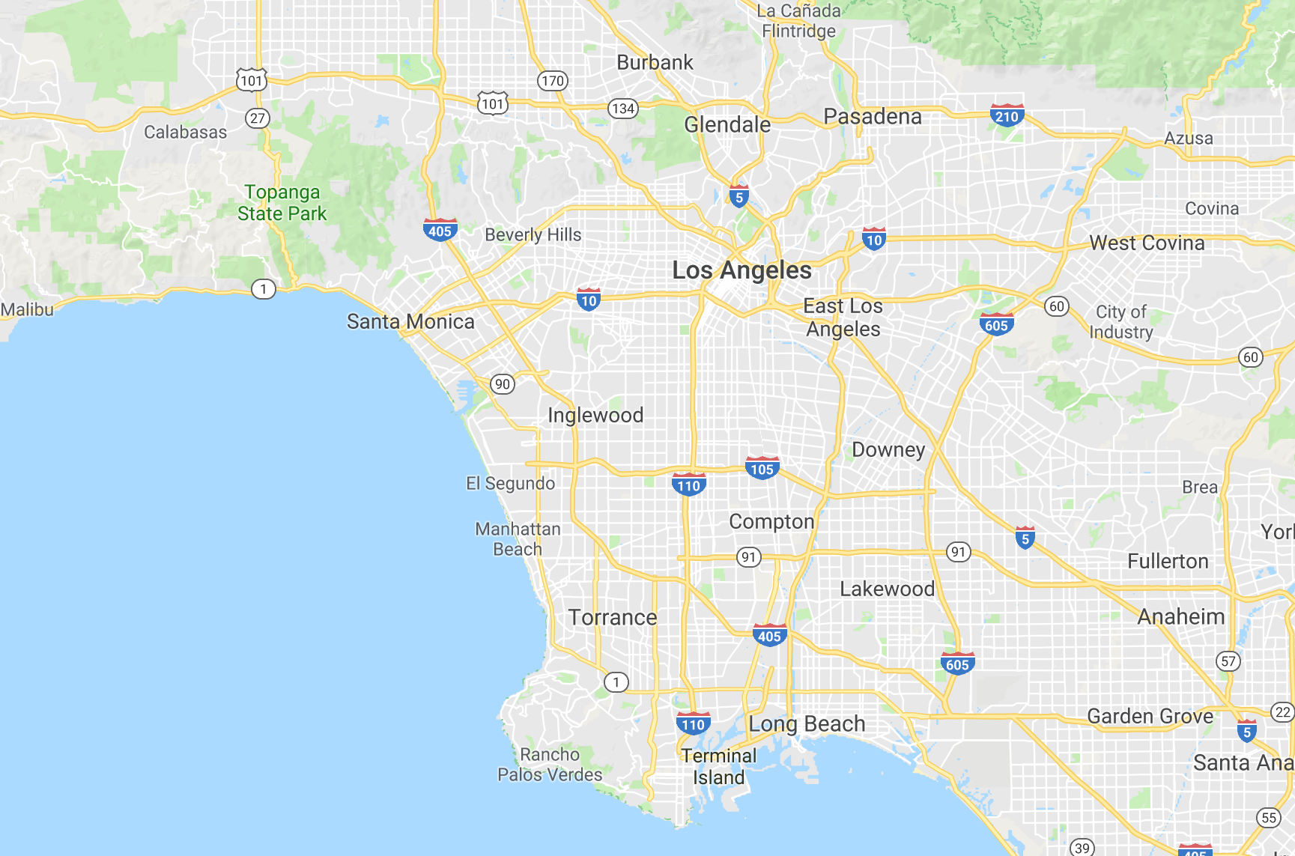
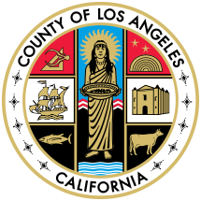
Greater Los Angeles Activities Guide
How to use guide:
Open in presentation mode
Each colored square represents a region of the greater LA area
Clicking on a square jumps directly to the details of that location
Click on the LA seal to jump back to this page
Each detailed section contains relevant hyperlinks to each identified location and potential recommendations
Presentation as of December 28, 2018

Slide 2
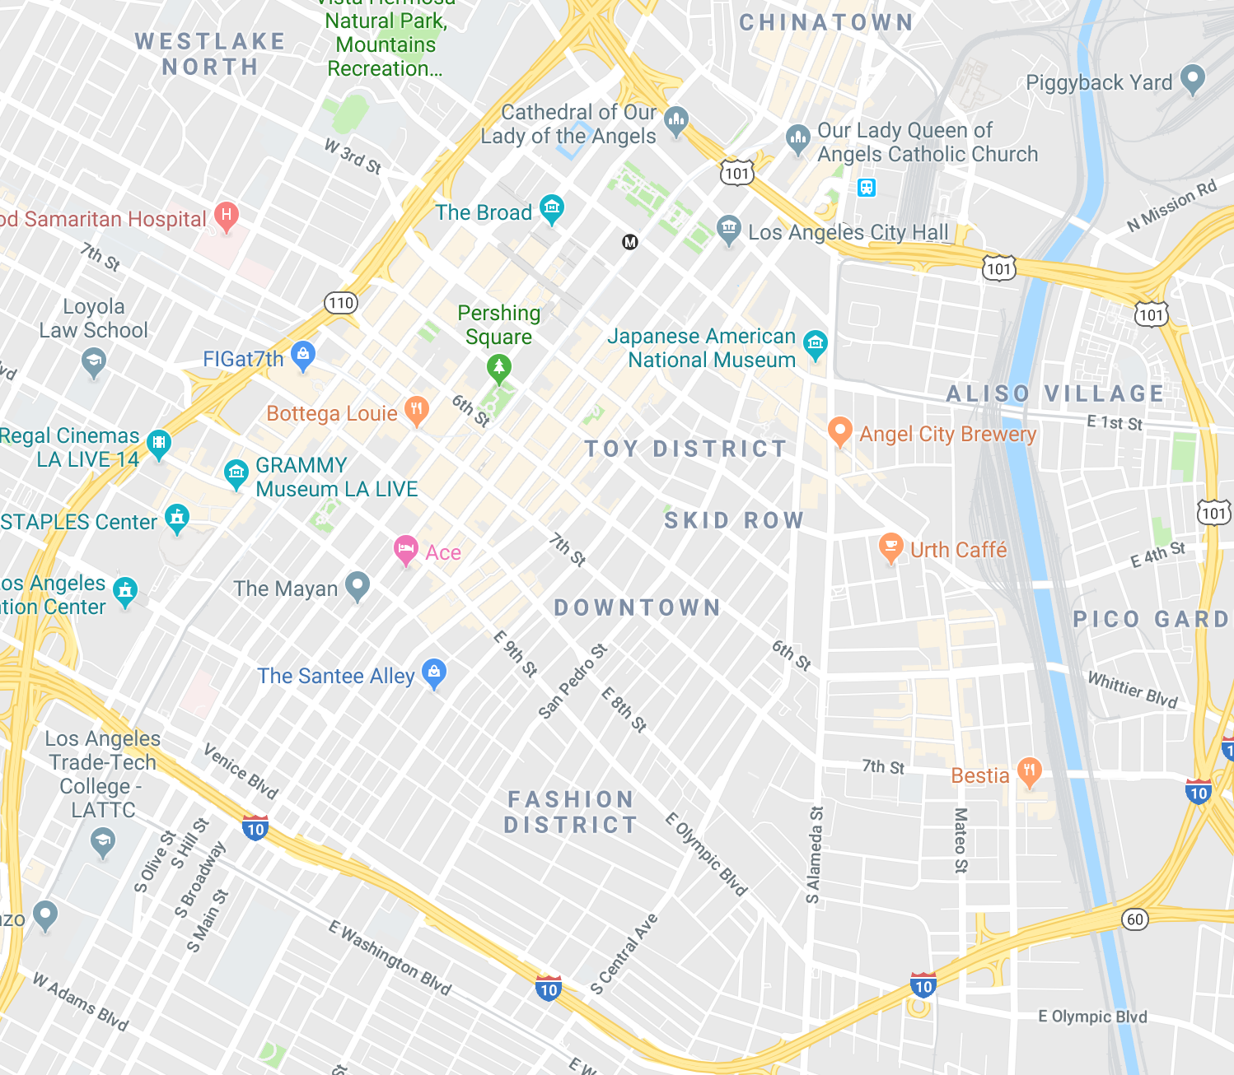
Downtown LA
1
4
LA Music Center
The Broad Museum
Cathedral of Our Lady of the Angels
LA Museum of Contemporary Art
Grand Central Market and Angel’s Flight
LA City Hall and Grand Park
Little Tokyo
OUE Sky Lounge and Glass Slide
Staples Center and LA LIVE
2
3
5
8
7
6
9

Slide 3
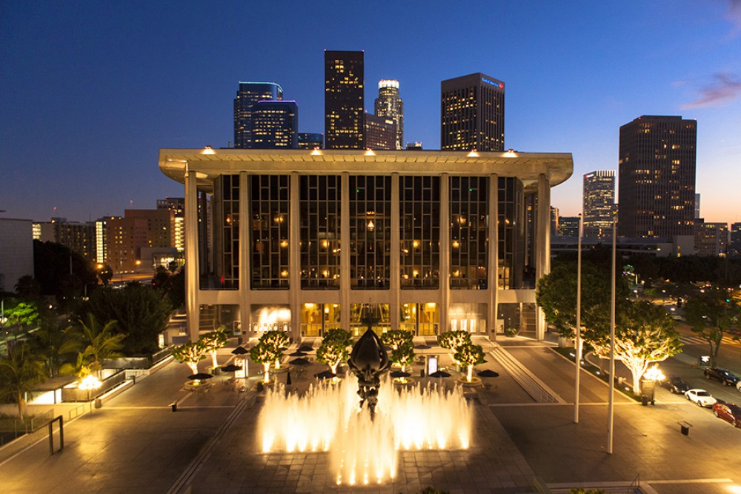
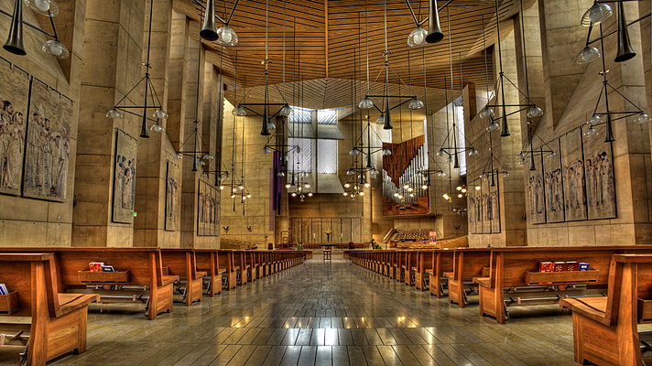
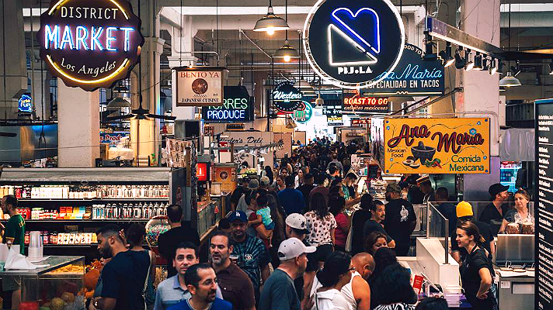
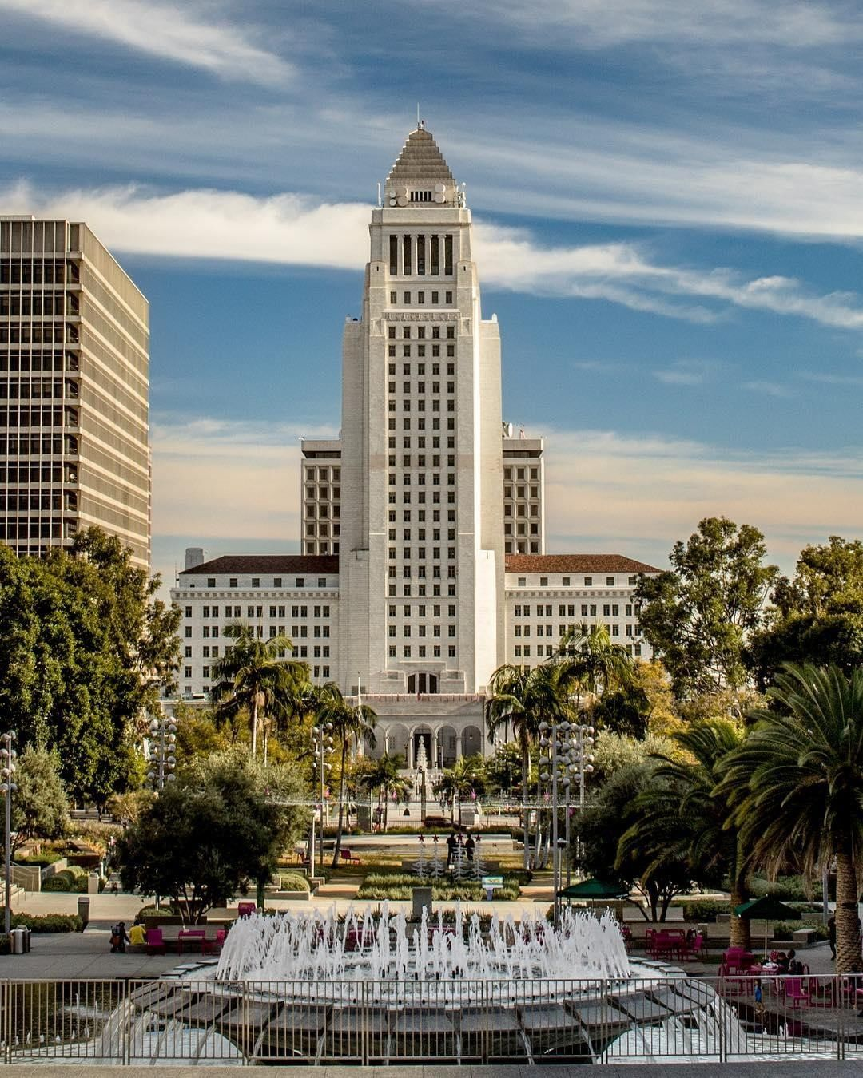
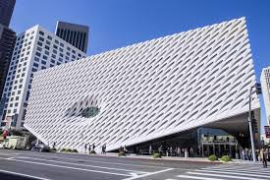
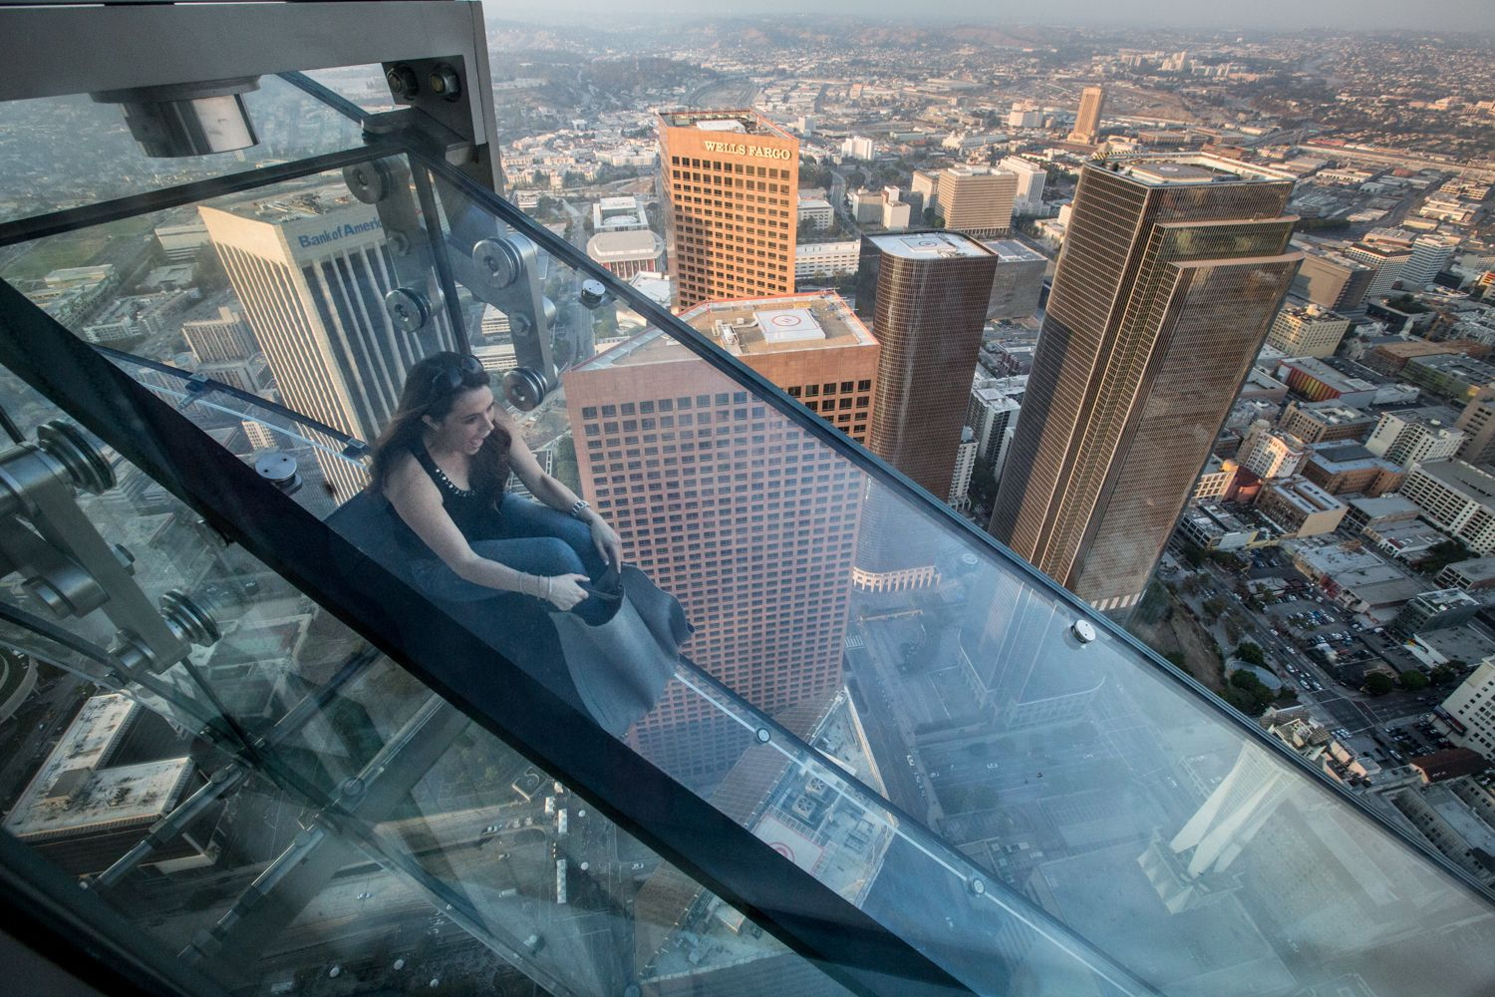
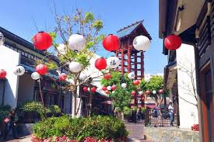
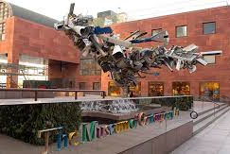
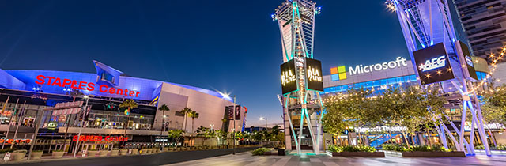
Downtown LA
LA Music Center
https://www.musiccenter.org/visit/Exploring-the-Center/Symphonians-Tours/
Cathedral of Our Lady of the Angels
http://www.olacathedral.org/
Grand Central Market
http://www.grandcentralmarket.com/
Recommendation: Attend a Symphonian Tour which allows for access into all 4 facilities of the LA Music Center
Recommendation: Free Organ Recital on Wednesdays at 12:45pm
Recommendation: Most popular vendor is Eggslut. Common wait times can last up to an hour
* Angel’s Flight is next to the Grand Central Market’s West Entrance
The Broad Museum
https://www.thebroad.org/visit
LA City Hall and Grand Park
https://www.laconservancy.org/locations/los-angeles-city-hall
OUE Sky Lounge and Glass Slide
https://oue-skyspace.com/
Recommendation: Obtain advance tickets a month in advance otherwise will need to wait in standby line. Also, best to get earliest ticket in order to sign up for the Infinity Mirror Room exhibit which is on a first-come, first-served sign up sheet just inside the main entrance
Recommendation: Free
observation platform at
city hall with views of the
city. Ask security guard at
front desk on how to access
Recommendation: Not worth the price
Little Tokyo
https://www.timeout.com/los-angeles/little-tokyo
Staples Center and LA Live
https://www.lalive.com/
LA MOCA
https://www.moca.org/
Recommendation:
Free admission
every Thursday from 5:00-8:00pm
Recommendation: Come early for ramen at
Daikokuya which can have wait times up to 2 hours

Slide 4
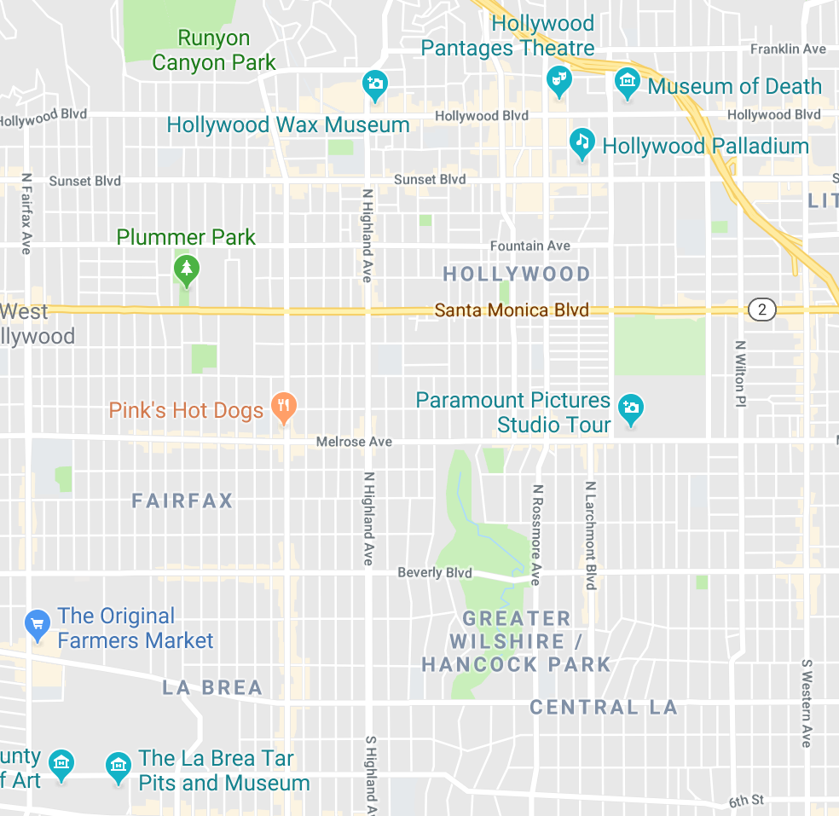
Hollywood and Central LA
3
TCL Chinese Theatres (formerly known as Grauman’s Chinese Theatre) and Dolby Theatre
Hollywood Pantages Theatre
Magic Castle
LA County Museum of Art
La Brea Tar Pits
The Grove
The Original Farmers Market
1
2
7
6
4
5

Slide 5
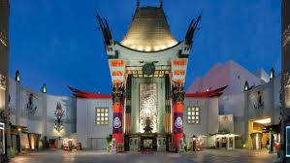
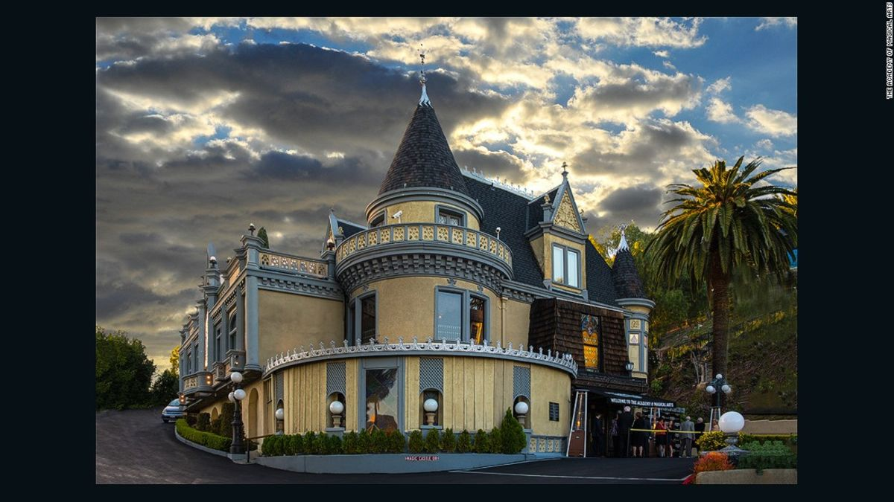
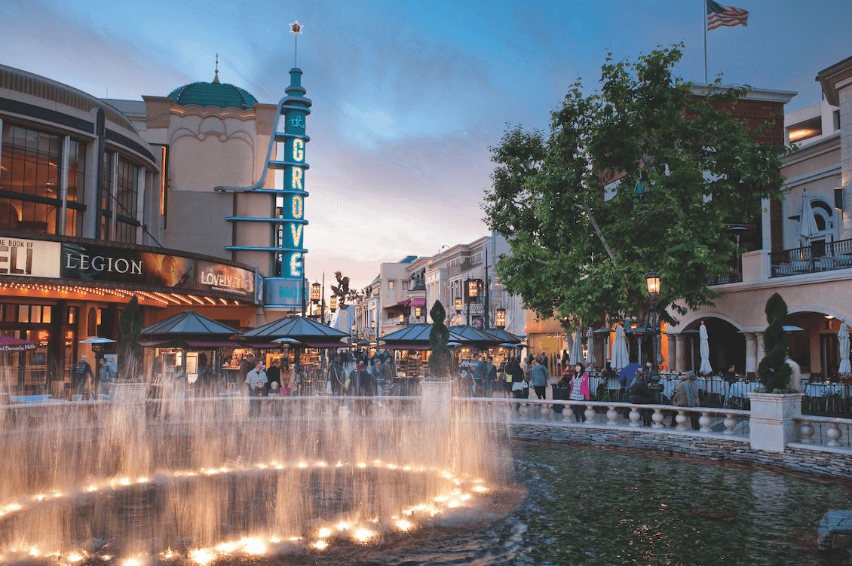
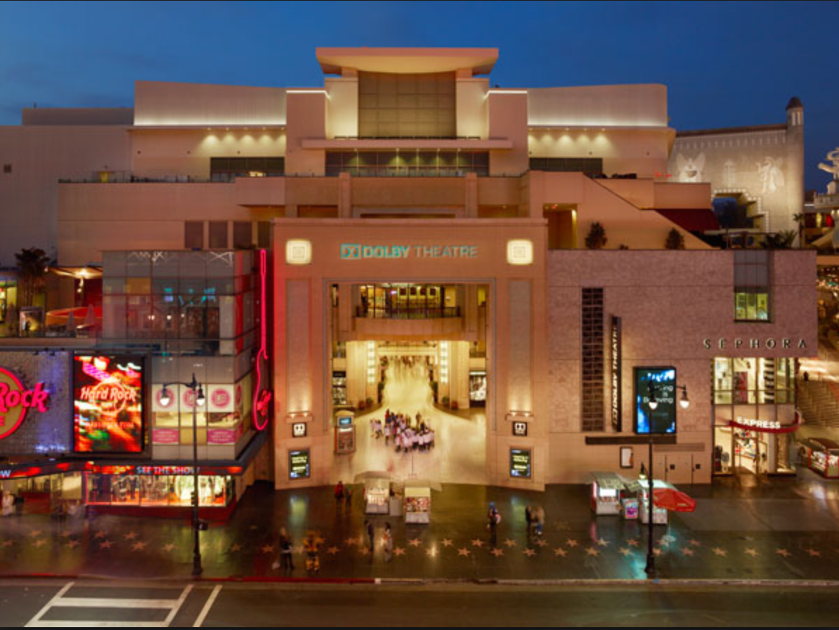
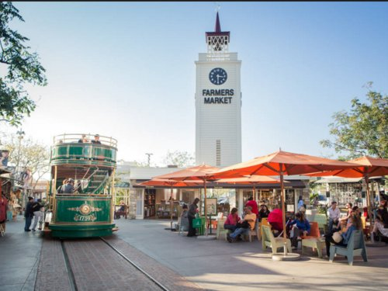
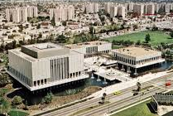
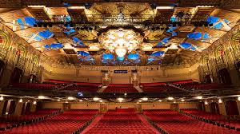
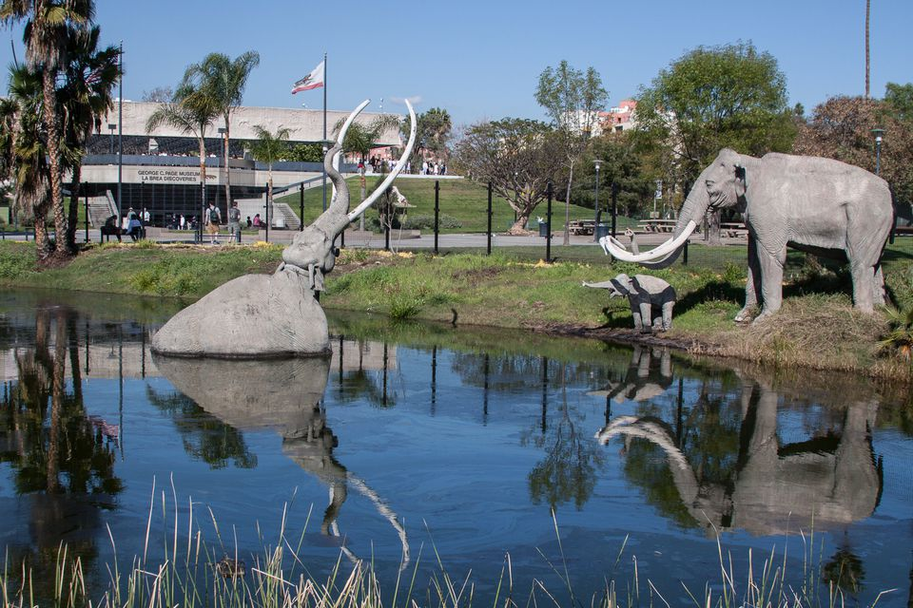
Hollywood and Central LA
TCL Chinese Theatre
http://www.tclchinesetheatres.com/
Magic Castle
http://www.magiccastle.com/
The Grove
https://thegrovela.com/
Recommendation: Can find the famous hand and footprints of celebrities here
Recommendation: Requires invite from a current member in order to enter. Another option is to stay at the Magic Castle Hotel
Recommendation: Eat at The Original Farmers Market across the street (to the West)
Dolby Theatre (Hollywood & Highland)
https://dolbytheatre.com/
The Original Farmers Market
https://www.farmersmarketla.com/
LA County Museum of Art
http://www.lacma.org/
Recommendation: Location where the Oscars are held. Can see the Hollywood sign from here
Recommendation: Free 90 minutes parking with validation (in addition to 1 hour free parking at the Grove)
Recommendation: Famous for the artwork Urban Light
Hollywood Pantages
https://www.hollywoodpantages.com/
La Brea Tar Pits
https://tarpits.org/
Recommendation: Find popular Broadway musicals performing during dates of travel

Slide 6
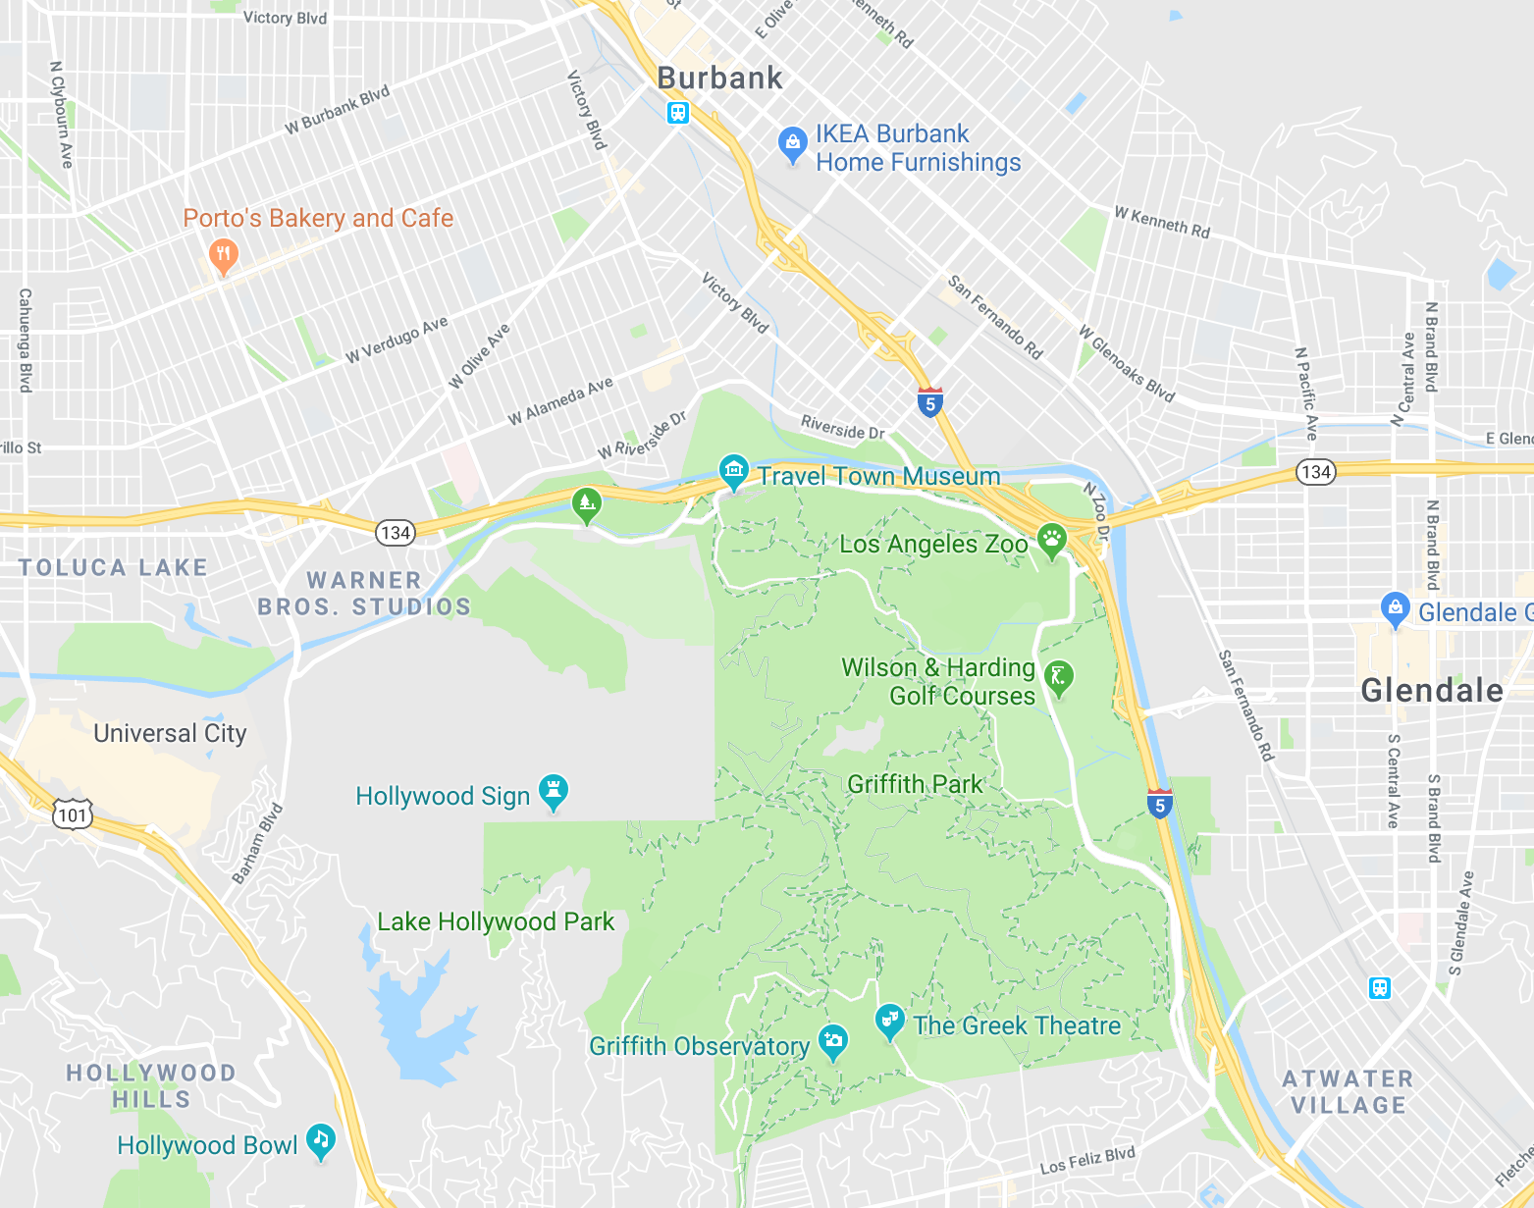
Griffith Park Area
Griffith Observatory
Hollywood Bowl
Los Angeles Zoo
Universal Studios Hollywood
Glendale Galleria and Americana
Warner Bros. Studio Lot Tour
Hollywood Sign
6
3
5
4
7
1
2

Slide 7
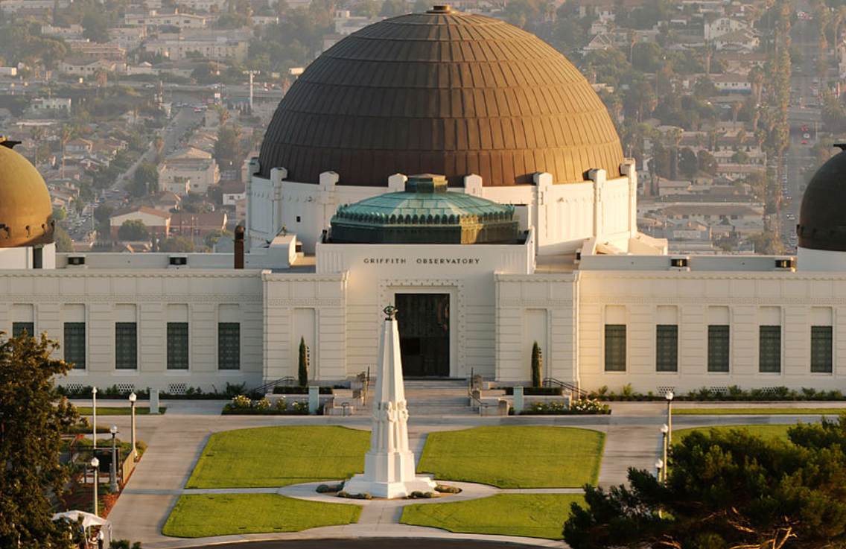
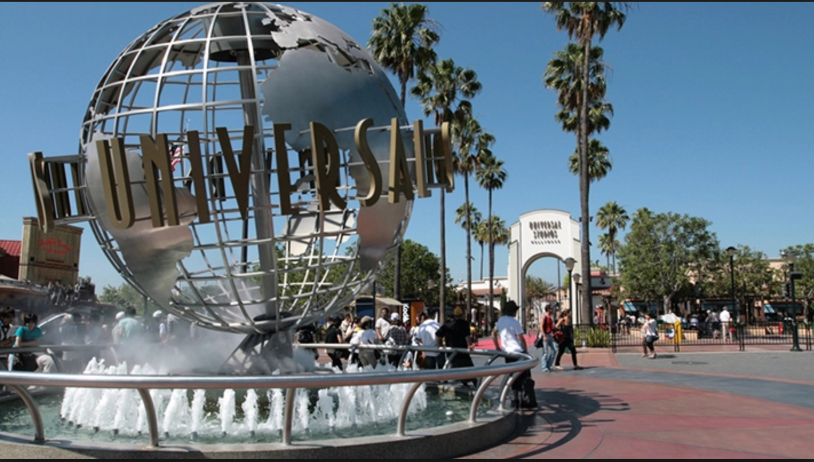
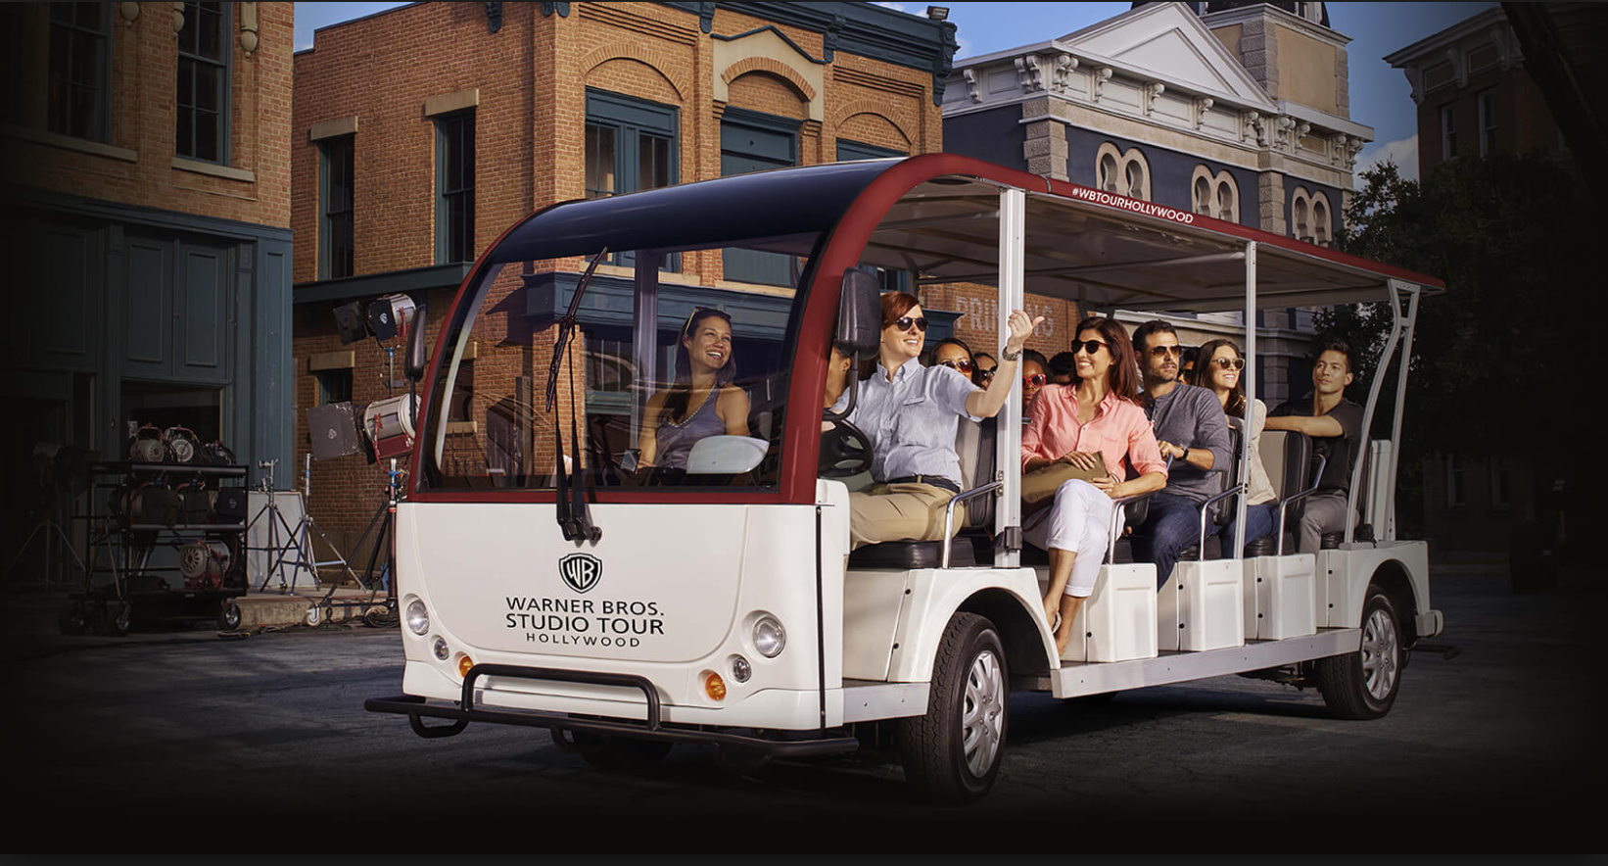
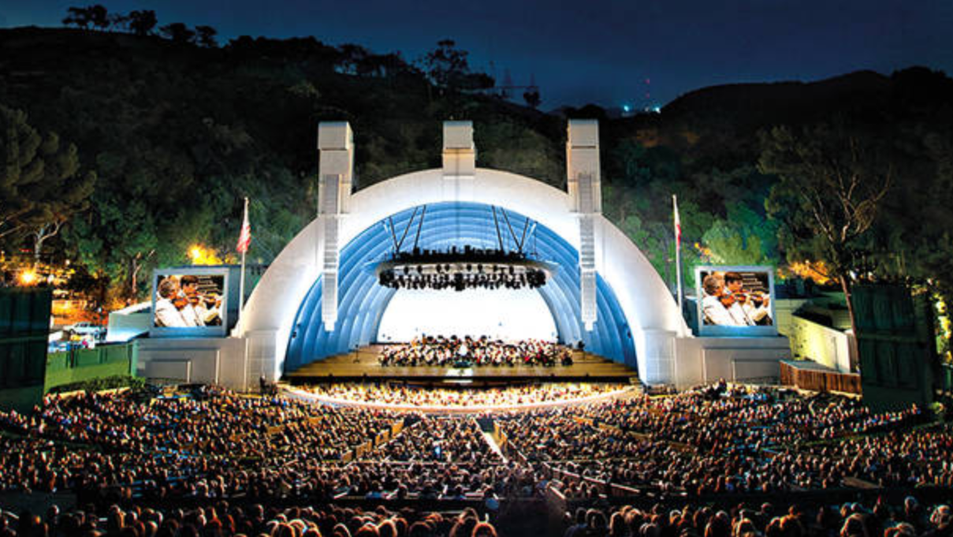
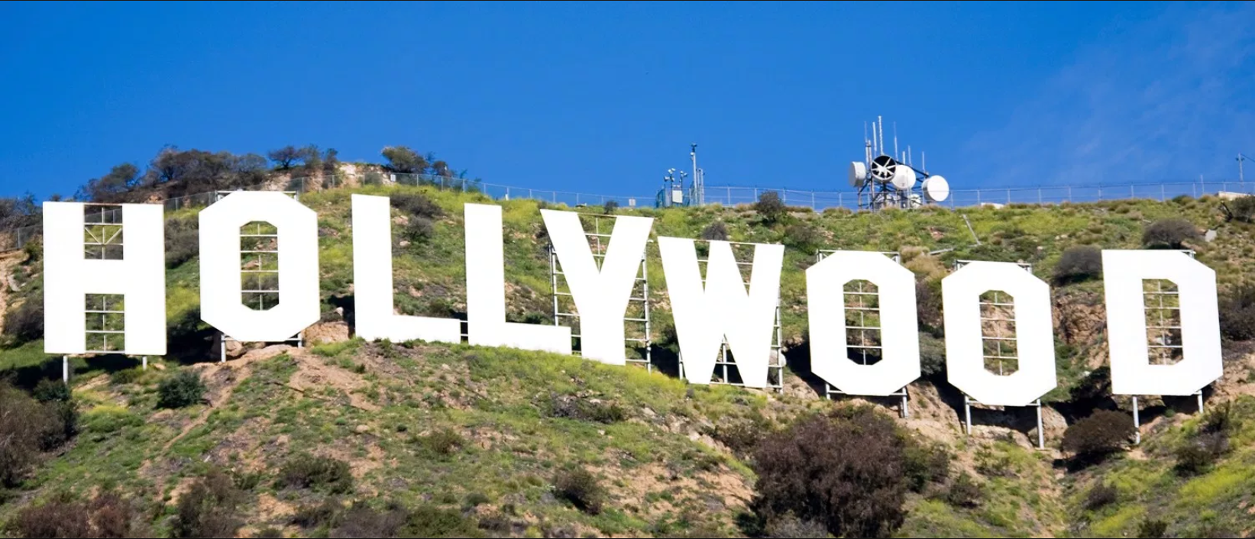
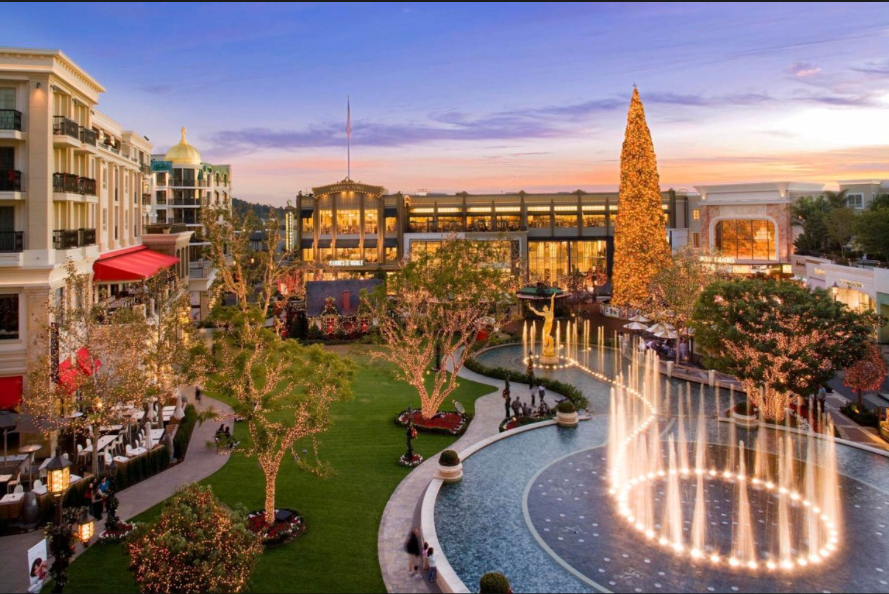
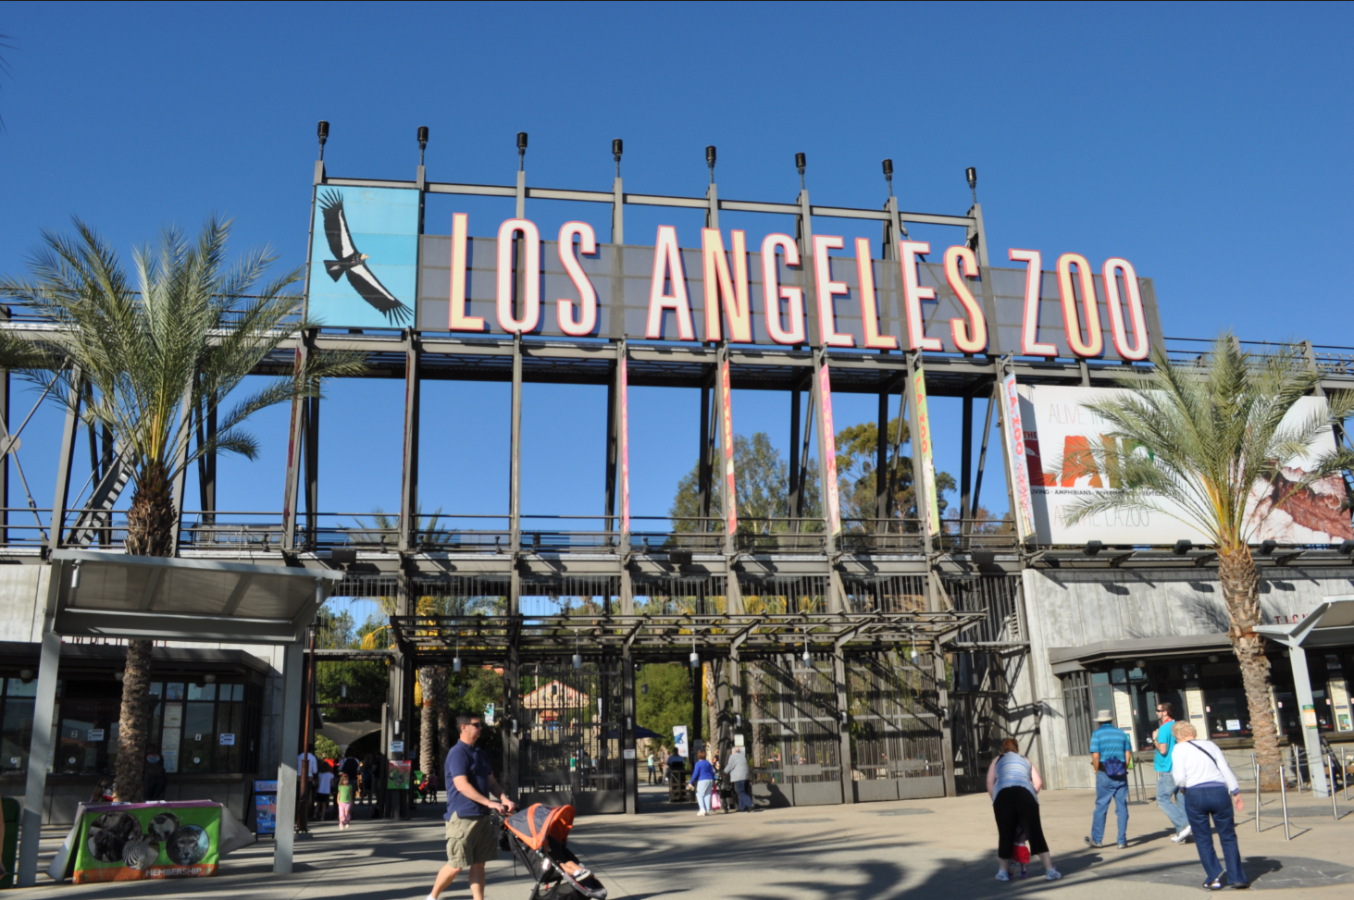
Griffith Park Area
Griffith Observatory
http://griffithobservatory.org/
Universal Studios Hollywood
https://www.universalstudioshollywood.com/
Warner Bros. Studio Lot Tour
https://www.wbstudiotour.com/
Recommendation: Hike up Firebreak Trail (park on Fern Dell Dr. before sunset, otherwise, park south of Los Feliz Blvd street parking). Amazing views of Downtown LA (especially during sunset)
Recommendation: Reserve tickets early to guarantee preferred time slot. Children under 8 are not permitted on the tour
Recommendation: Go early to beat the crowds at the Wizarding World of Harry Potter (and the Studio Tour attraction)
Top Recommended Attractions:
Harry Potter and the Forbidden Journey
Studio Tour
Fast & Furious - Supercharged
Transformers: The Ride
Jurassic Park: The Ride
Hollywood Sign
https://hollywoodsign.org/
Hollywood Bowl
https://www.hollywoodbowl.com/
Recommendation: Find popular concerts / performances during dates of travel
Glendale
Galleria and
Americana
https://www.glendalegalle
ria.com/en.html
https://americanaatbrand.com/
Recommendation: Can hike up to the sign but better viewing it from afar from Griffith Observatory or Dolby Theatre (Hollywood & Highland)
Los Angeles Zoo
https://www.lazoo.org/
Recommendation: Park at Glendale Galleria (free parking) and walk to Americana at Brand

Slide 8
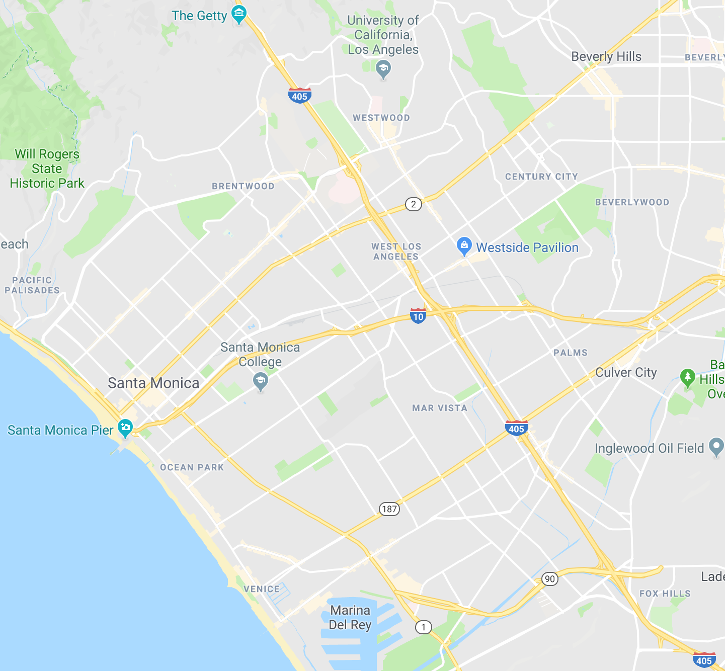
Westside
4
Santa Monica Pier
Venice Beach Boardwalk
Venice Canals
The Getty Center
Westwood
5
1
2
3

Slide 9
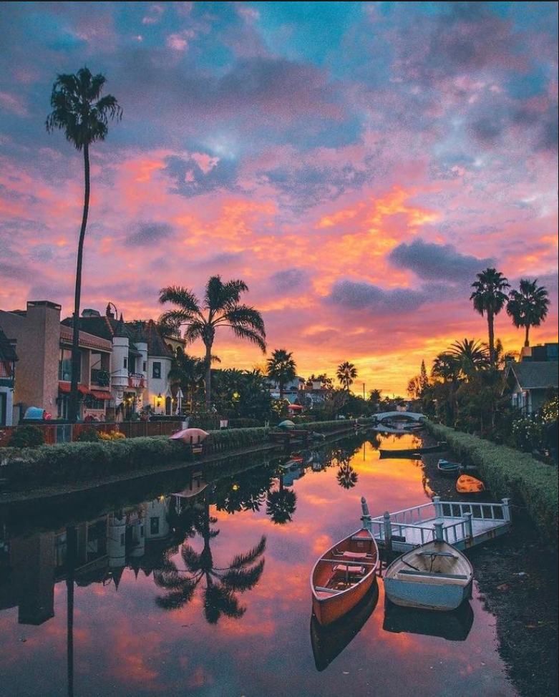
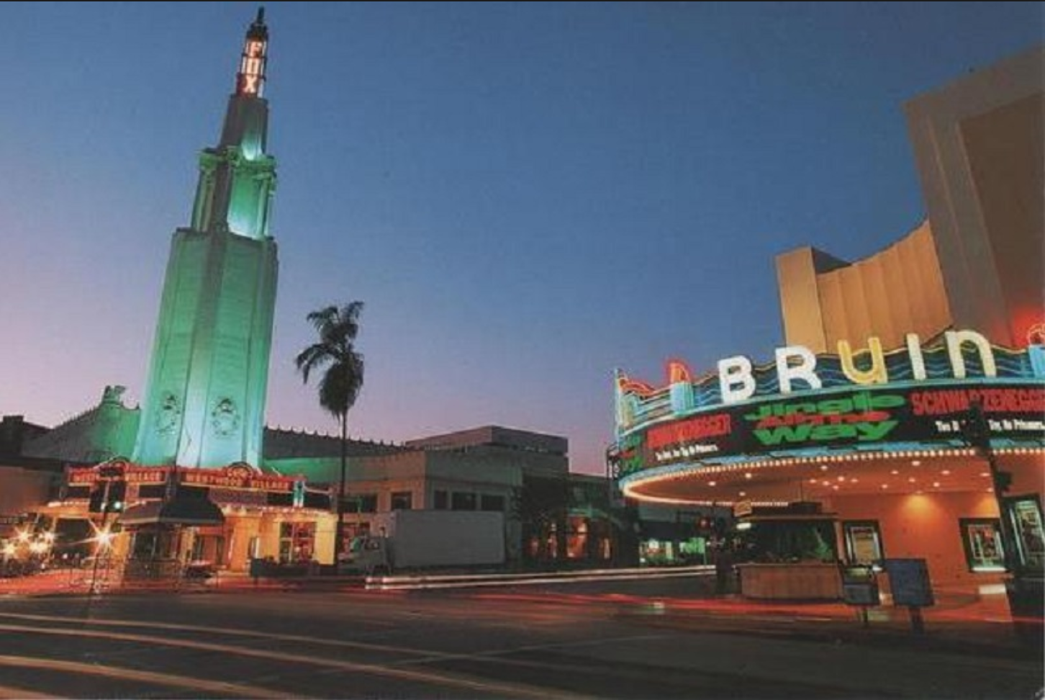
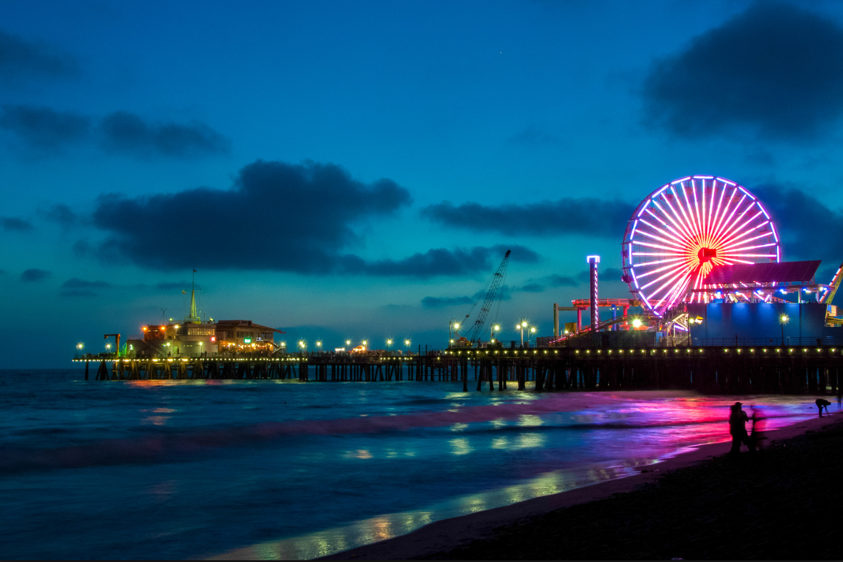
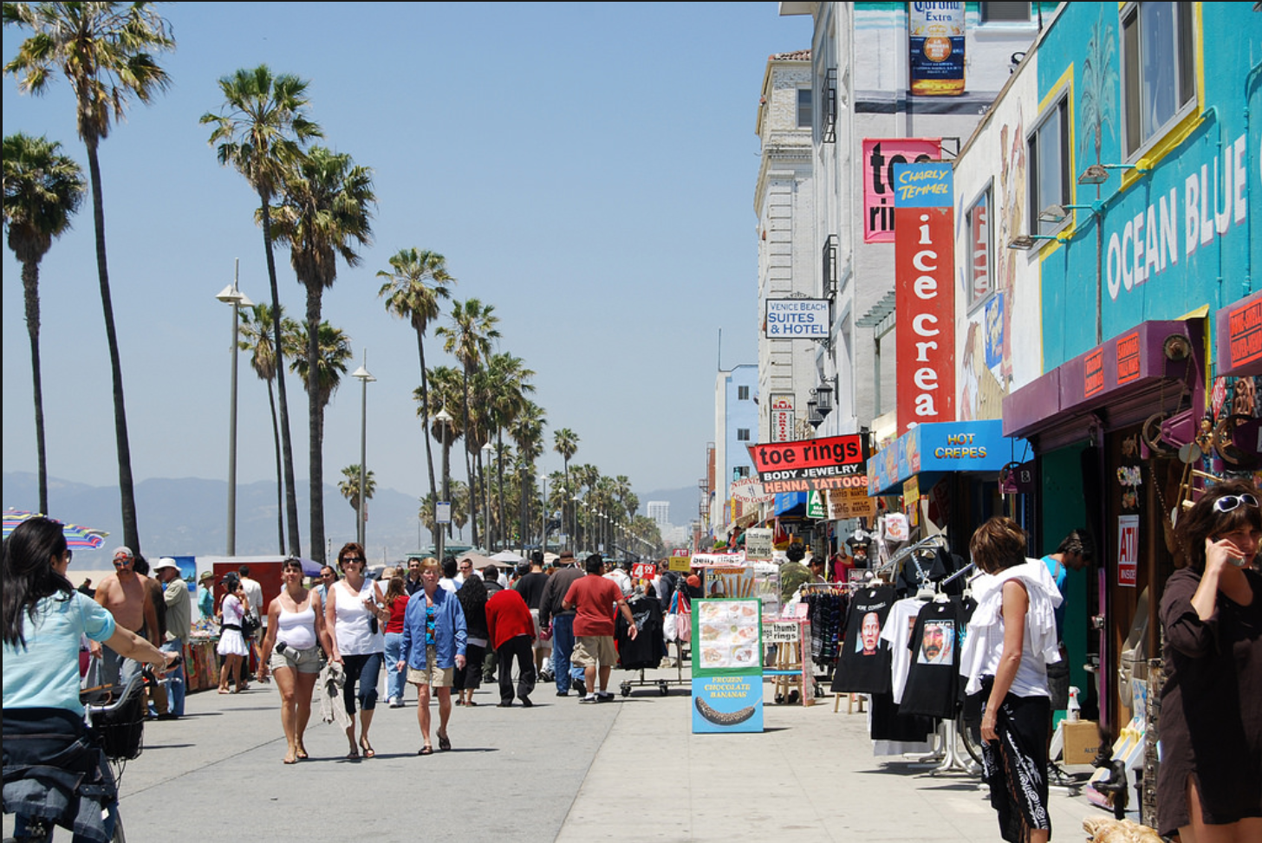
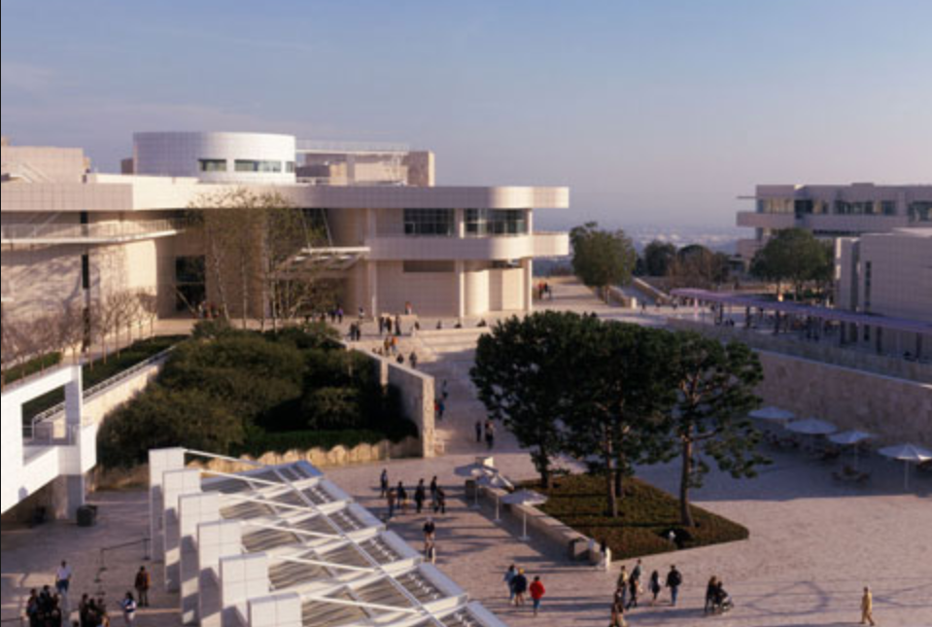
Westside
Santa Monica Pier
https://santamonicapier.org/
Venice Canals
https://californiathroughmylens.com/venice-canals-near-venice-beach
Westwood
https://theculturetrip.com/north-america/usa/california/articles/10-best-things-to-do-and-see-in-las-westwood/
Recommendation: Free 90 minutes parking in Parking Structures 1-8. Pier becomes extremely crowded on weekends
Recommendation: Nice place to walk through on way to Venice Beach (better parking as well)
Recommendation: The neighborhood surrounding UCLA. Home to the popular ice cream sandwich shop Diddy Riese
Venice Beach Boardwalk
https://www.venicebeach.com/the-venice-beach-boardwalk/
The Getty Center
https://www.getty.edu/museum/
Recommendation: Popular for Muscle Beach and Skate Park. Park near Venice Canals and walk over
Recommendation: Free admission but parking is $15 ($10 after 3pm). Sometimes runs out of parking on weekends

Slide 10
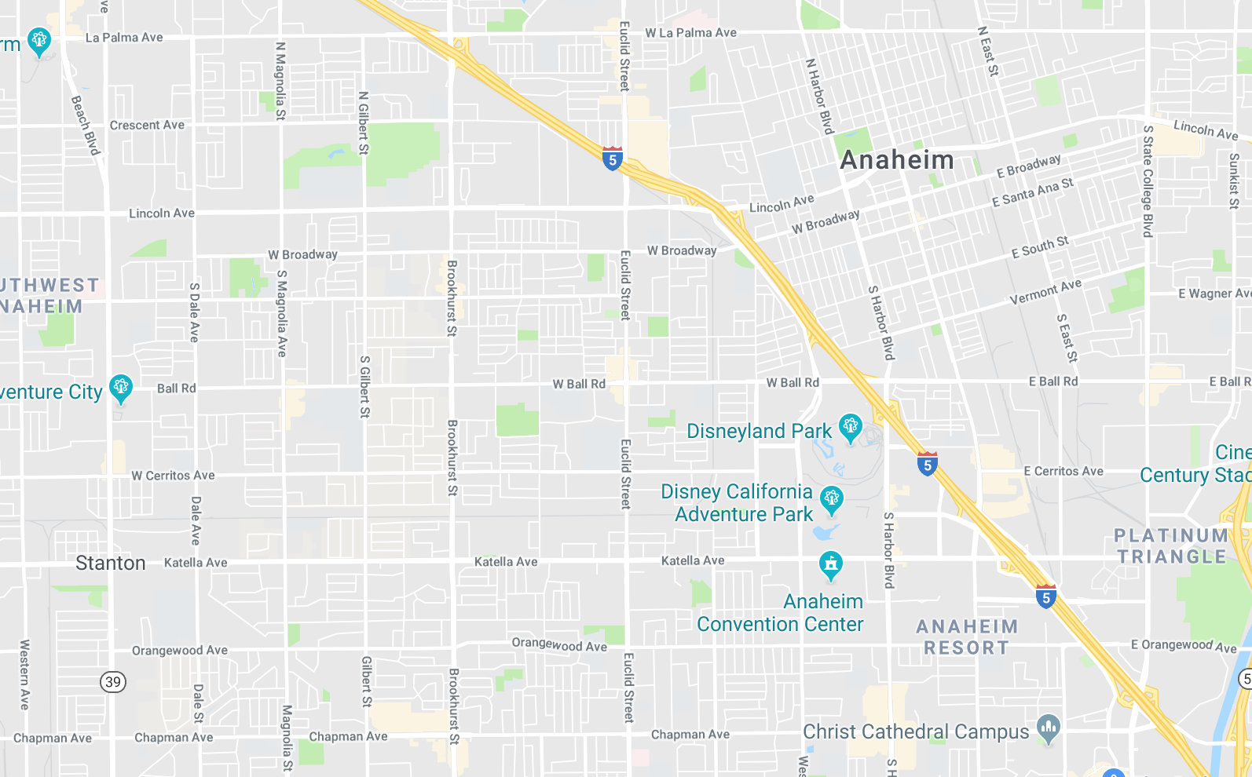
Anaheim
Disneyland Resort
Knott’s Berry Farm
Angel Stadium
Christ Cathedral
2
1
3
4

Slide 11
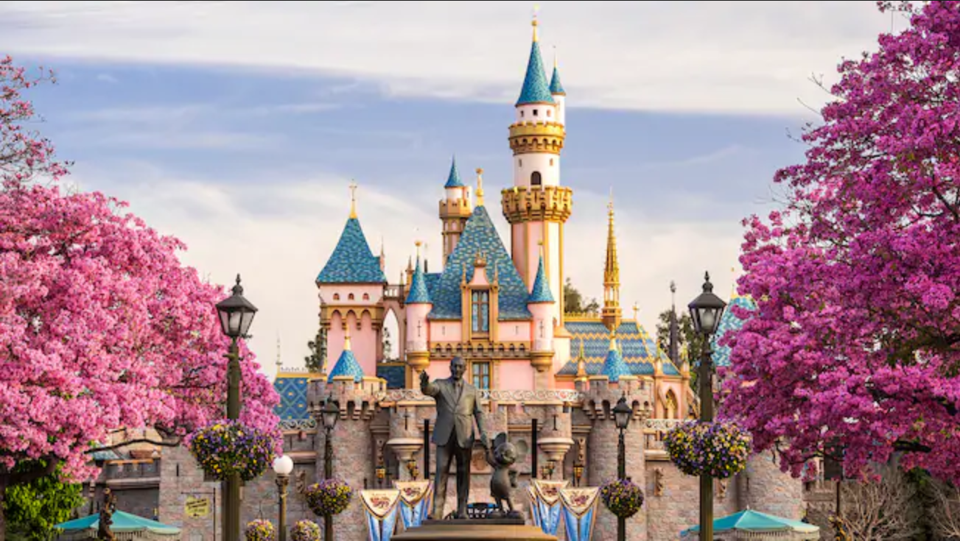
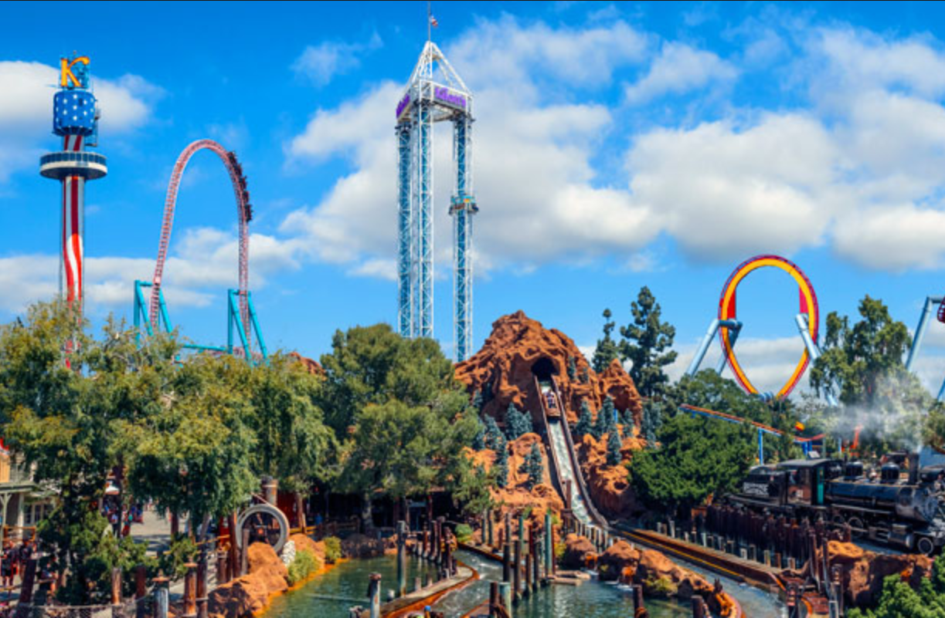
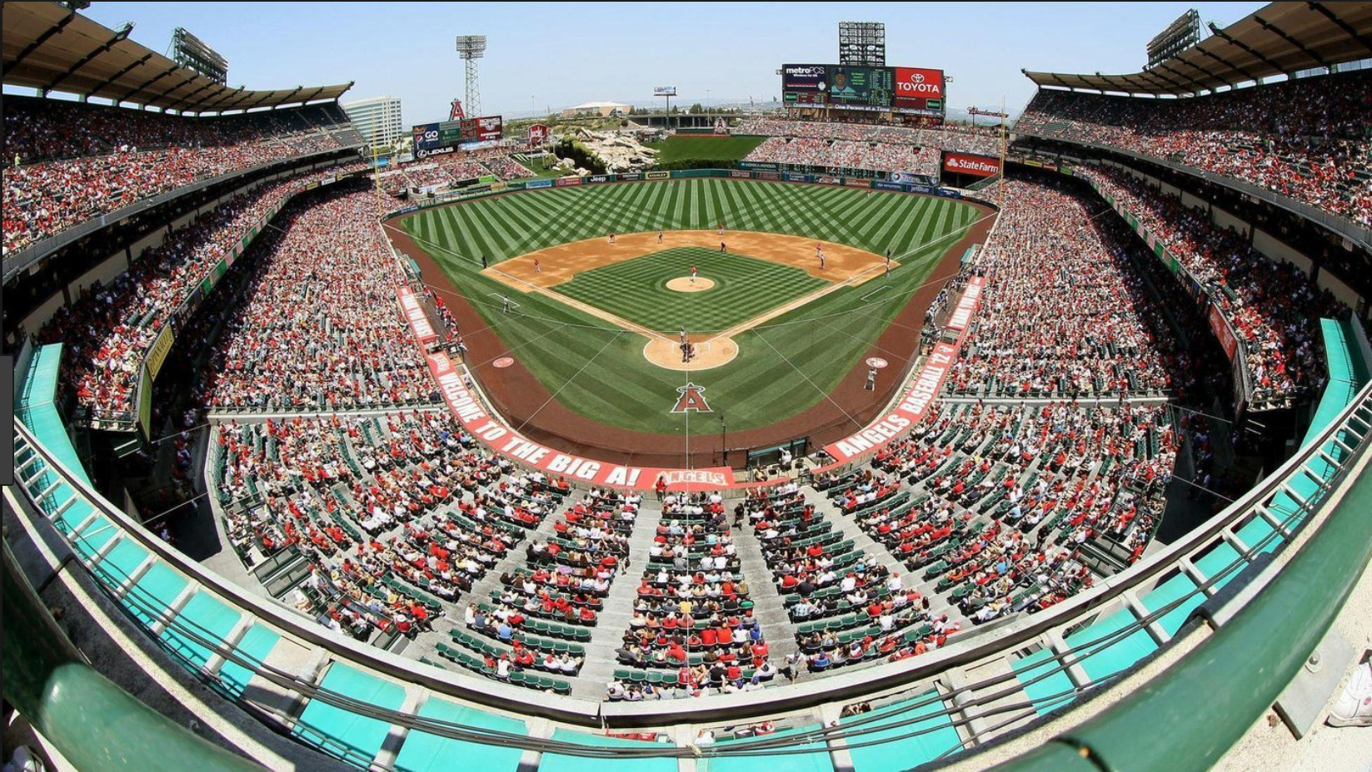
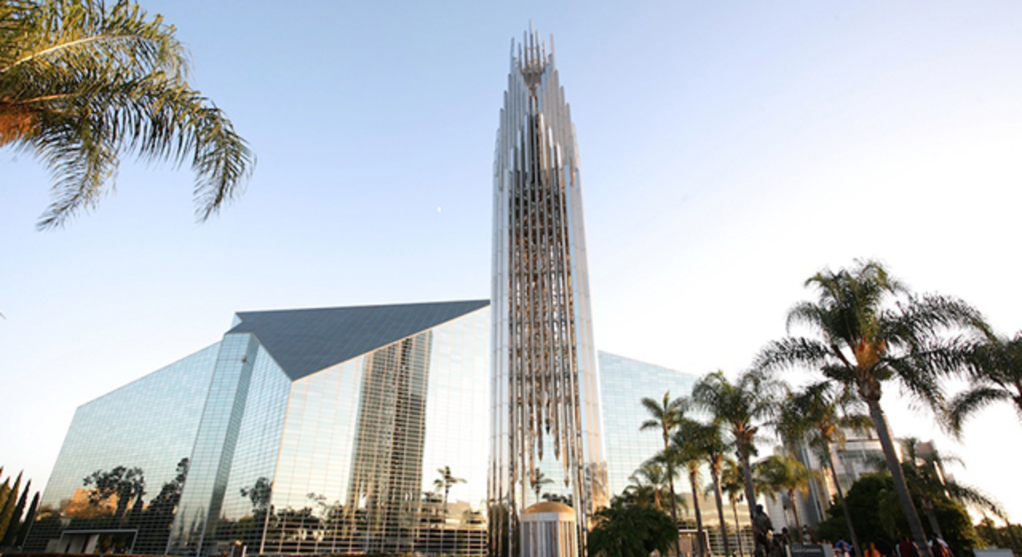
Anaheim
Disneyland Resort
https://disneyland.disney.go.com/
Knott’s Berry Farm
https://www.knotts.com/
Angel Stadium
https://www.mlb.com/angels/ballpark
Recommendation: Home to two parks, Disneyland and California Adventure. Can buy a park hopper to access both parks on the same day as they are right across from each other
Top Recommended Attractions:
Disneyland
Space Mountain
Matterhorn
Big Thunder Mountain Railroad
Splash Mountain
Indiana Jones Adventure
Together Forever (Fireworks Show)
Fantasmic (Nighttime Show)
California Adventure
Radiator Springs Racers
Mission: Breakout!
Soarin’ Around the World
Incredicoaster
Toy Story Mania
World of Color (Nighttime Show)
Recommendation: Also home to Soak City Water Park. This park contains more thrill rides but much smaller than Disneyland
Top Recommended Attractions:
Xcelerator
GhostRider (super old and rickety now)
Supreme Scream
Silver Bullet
HangTime
Christ Cathedral
https://christcathedralcalifornia.org/
Recommendation: Also known as Crystal Cathedral, famous for its architectural design

Slide 12
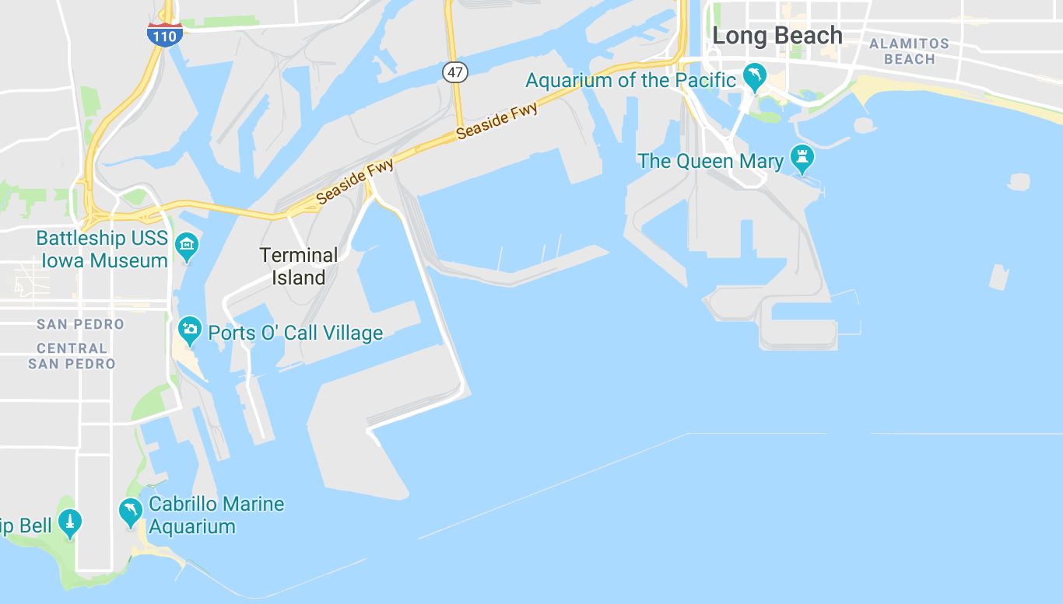
Long Beach
The Queen Mary
Aquarium of the Pacific
Battleship USS Iowa Museum
Korean Friendship Bell
San Pedro Fish Market
2
1
3
5
4

Slide 13
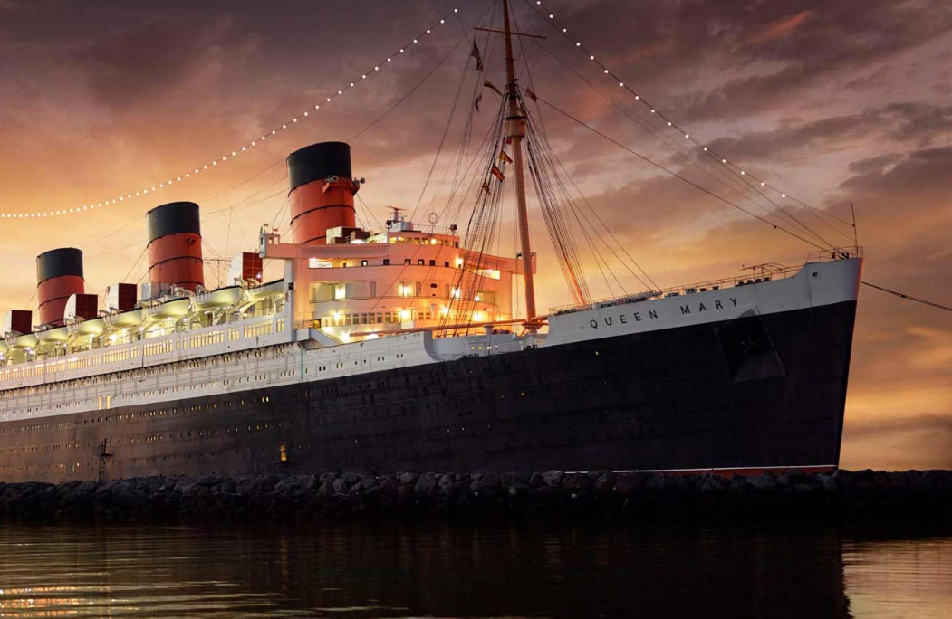
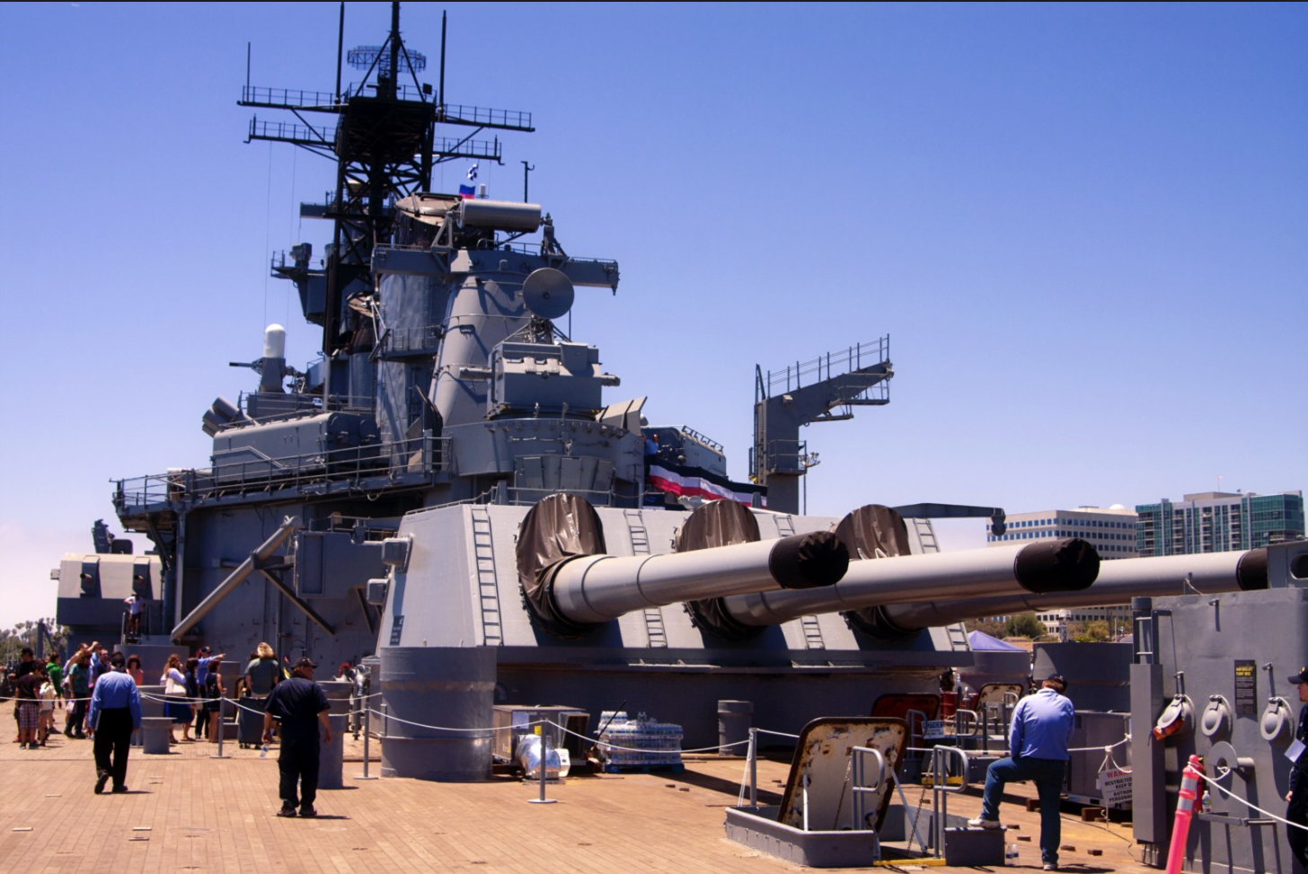
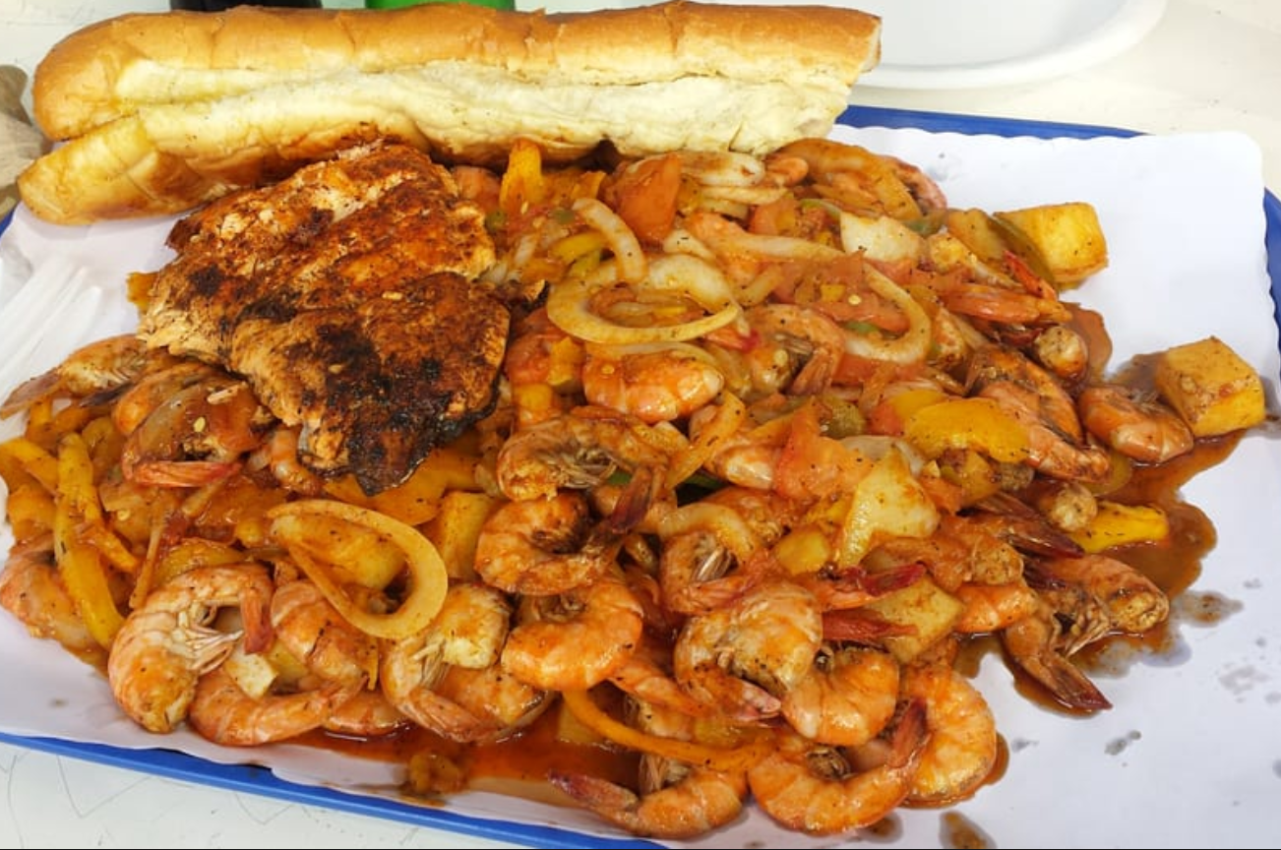
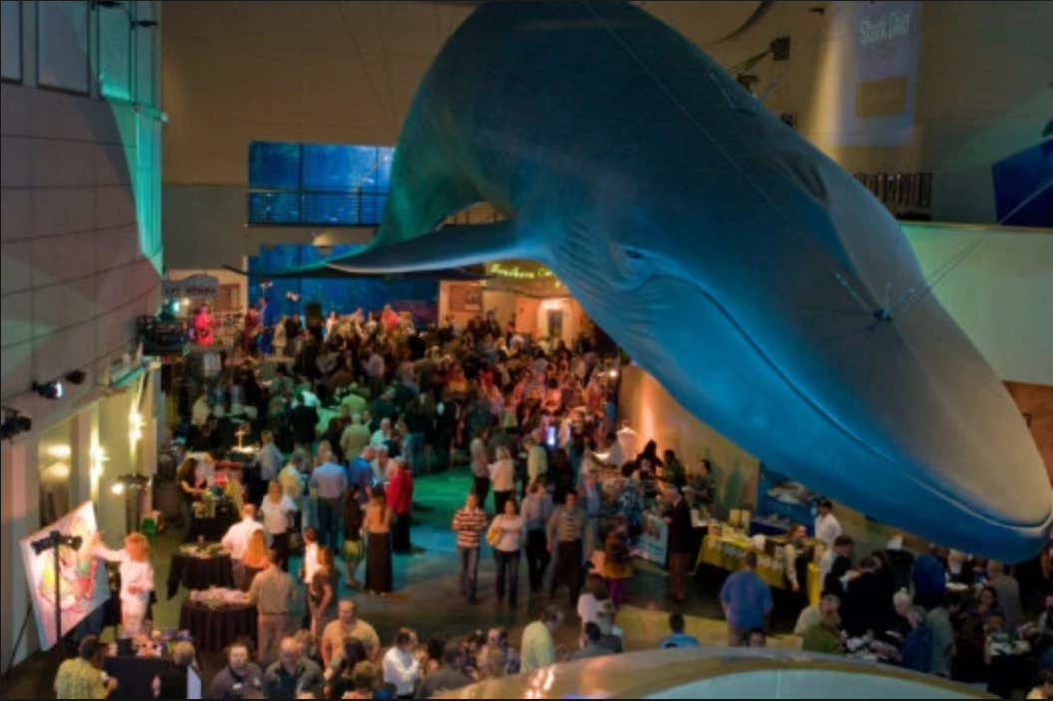
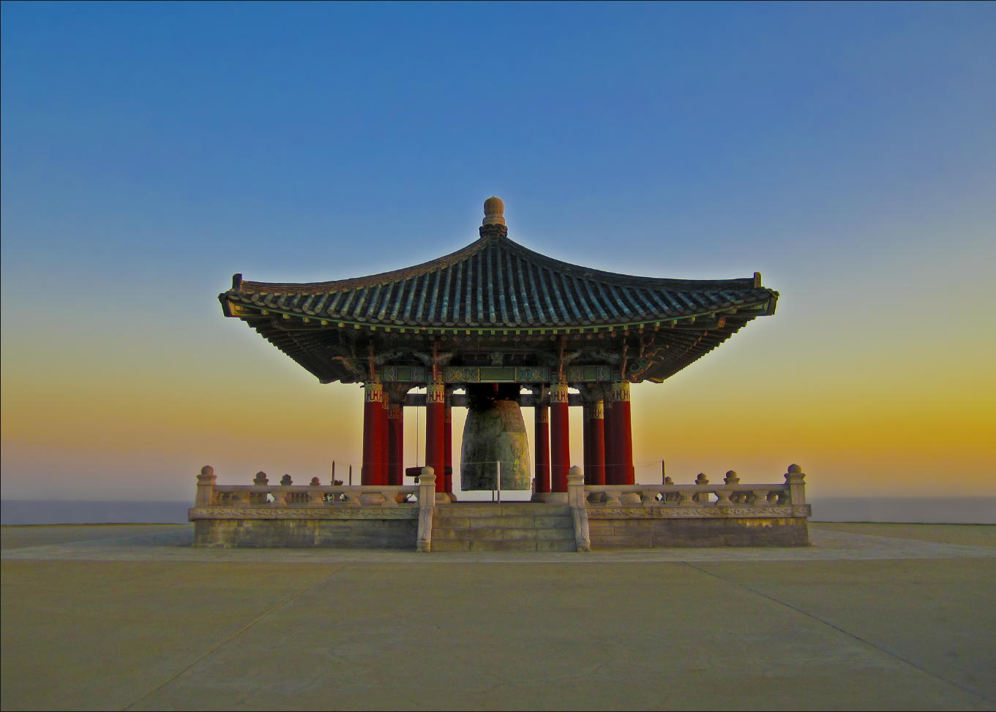
Long Beach
The Queen Mary
https://www.queenmary.com/
USS Iowa Museum
https://www.pacificbattleship.com/
San Pedro Fish Market
https://www.sanpedrofish.com/
Recommendation: Many of the attractions focuses on spirits and paranormal activities
Recommendation: Famous for the Shrimp Tray. All the seafood is piled high onto a tray for you to enjoy. Expect it to be a messy meal
Aquarium of the Pacific
http://www.aquariumofpacific.org/
Korean Friendship Bell
https://sanpedro.com/san-pedro-area-points-interest/korean-bell-friendship/
Recommendation: Considered one of the best aquariums in the world with notable exhibits such as the Shark Lagoon

Slide 14
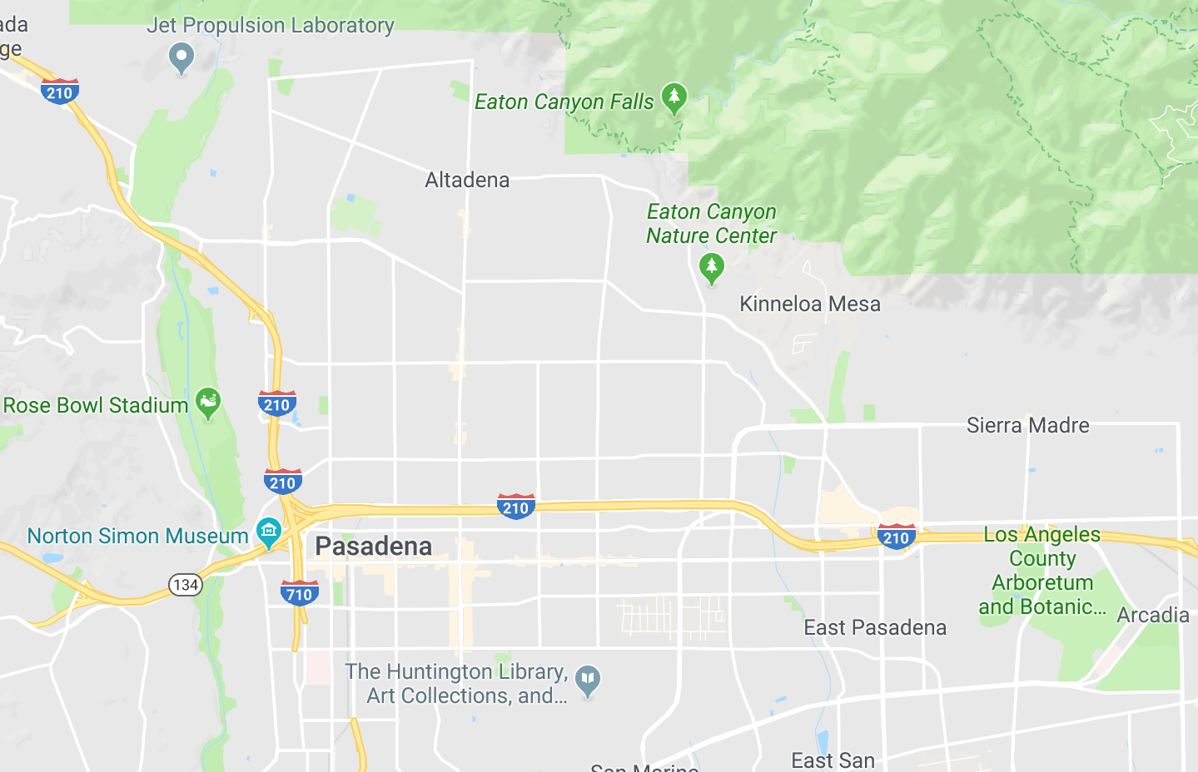
Pasadena Area
The Huntington
Los Angeles County Arboretum
Rose Bowl
Norton Simon Museum
Eaton Canyon Natural Area
Jet Propulsion Laboratory
Santa Anita Park
6
5
3
4
2
7
1

Slide 15
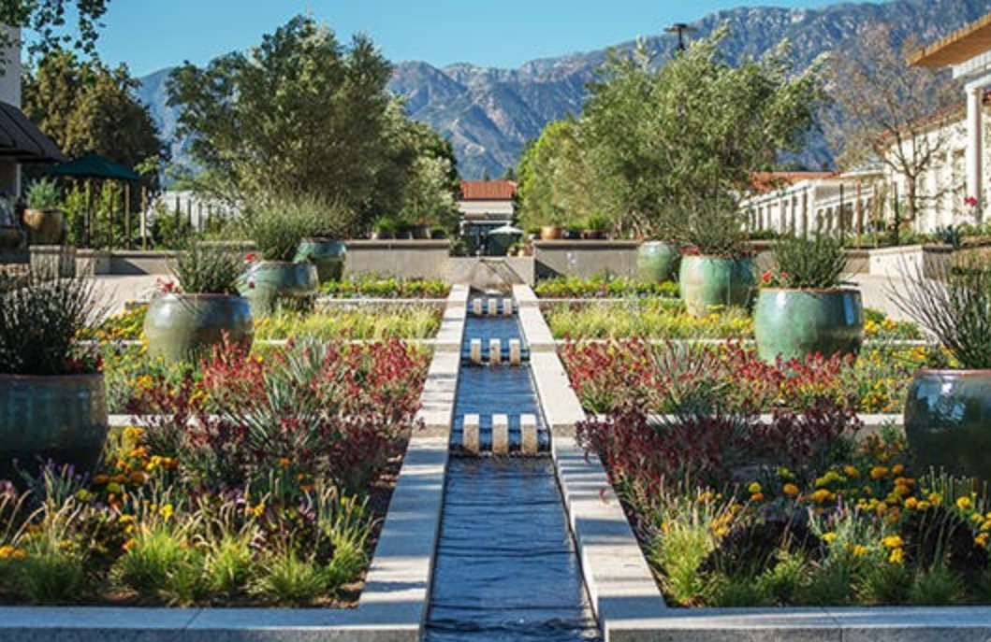
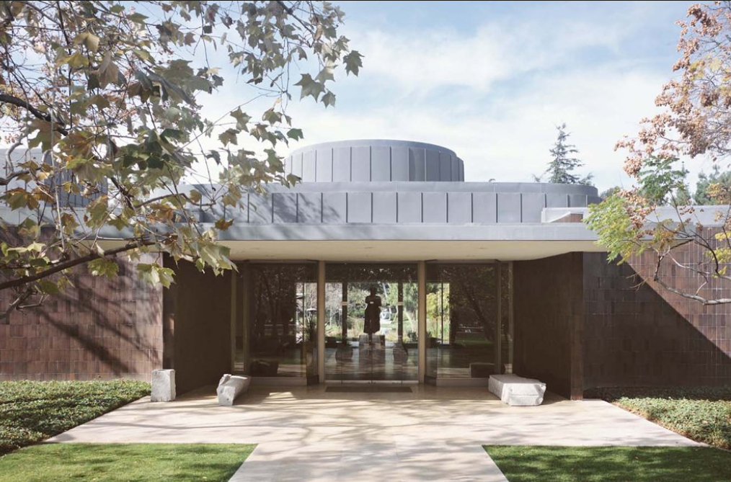
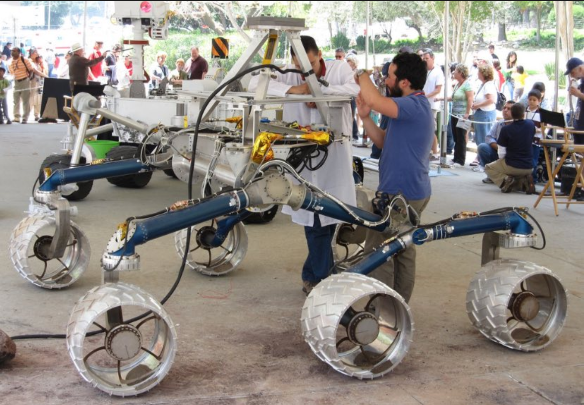




Pasadena Area
The Huntington https://www.huntington.org/
Norton Simon Museum
https://www.nortonsimon.org/
Jet Propulsion Laboratory
https://www.jpl.nasa.gov/
Recommendation: Contains themed gardens (Japanese and Rose gardens) in addition to famous works of art (The Blue Boy and Pinkie)
Recommendation: Exterior is famous for the telecast of the annual New Year’s Rose Parade. Free admission on the first Friday of every month from 5:00-8:00pm
Recommendation: Can reserve free group tours in advance (3 weeks minimum). If less than 10 people, only on Monday and Wednesdays generally at 1:00pm
The Arboretum
https://www.arboretum.org/
Eaton Canyon Natural Area
https://www.ecnca.org/
Santa Anita Park
http://www.santaanita.com/
Recommendation: Houses the original home of Lucky Baldwin
Recommendation: Free guided family nature walks every Saturday morning from 9:00-11:00am (no dogs allowed)
For more experienced hikers, can drive to the Sam Merrill Trailhead and hike up to Echo Mountain and Inspiration Point (10.4 miles roundtrip and 2,740 ft. elevation gain)
Recommendation: Horse racing occurs from early November through early April. Check the calendar for start times. Usually have 8 - 10 races on a given day. Don’t necessarily need to bet on races to enjoy the environment and the pageantry
Rose Bowl
https://www.rosebowlstadium.com/
Recommendation: Nothing much here unless there is an event being held on premises. It is surrounded by multiple parks

